Slide 1
Arthritis/Rheumatology Conditions
Part One/Course 1
Presentation by
Dr Rob Grieve
Thanks to Pete Ellyatt for additional slides.
Exercise Prescription for Special Populations
UZYKG9-15-3

Slide 2
Aims/Objectives/Content
Brief overview of pathophysiology related to arthritic/rheumatology conditions population-Set the Scene.
To recognise the benefits of physical activity and exercise in the management treatment of arthritic conditions.
Evaluate the current evidence available to support exercise in arthritic conditions/population.
To demonstrate evidence based practice in clinical exercise.

Slide 3
Arthritis/Rheumatology
Arthritis is a term for over 100 rheumatic conditions (Metsios et al., 2021) which together, when measured in years lived with disability (YLD) provides the second most common cause of disability in the United States (Theis et al., 2018) and worldwide (Global Burden of Disease Collaboration, 2013).
The disability burden of arthritis is rapidly escalating, with the YLD attributed OA alone increased globally by 75% from 1990 to 2013 (Global Burden of Disease Collaboration, 2013).
The two most common forms of arthritis are osteoarthritis (OA) and rheumatoid arthritis (RA), with the RA the most well-investigated inflammatory joint disease (ACSM, 2026).

Slide 4
Other Arthritic/Rheumatic diseases
Other common Arthritic Conditions (See Next Slide).
Regardless of type, arthritis is generally characterized by pain, impaired physical function, fatigue, and muscle loss and increased adiposity, with (a) 66% of individuals with OA being either overweight or obese at the time of disease onset (Metsios, et al., 2020) and (b) approximately two-thirds of RA patients experiencing rheumatoid cachexia, a condition characterized by loss of muscle mass and increased adipose tissue and metabolism, while body weight remains unchanged (Summers et al., 2010).
Due to the aging population and burgeoning obesity epidemic, the prevalence of physician- diagnosed arthritis is expected to increase to an estimated 78 million Americans (26%) by 2040 (Hootman et al., 2016), with the same trend anticipated globally (Global Burden of Disease Collaboration, 2013).

Slide 5
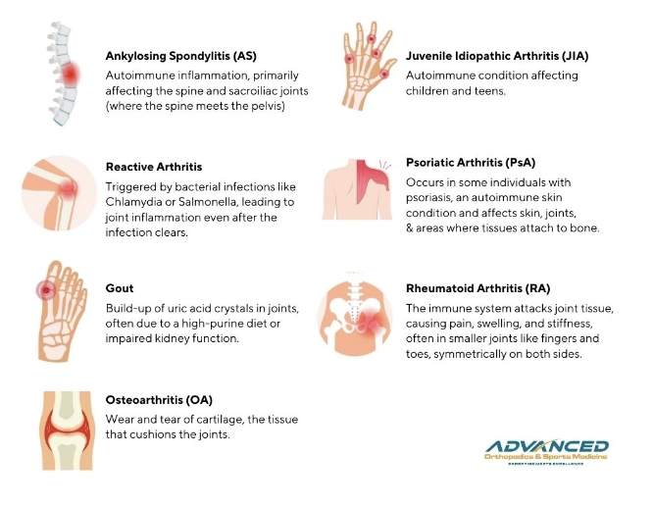
Common Arthritic Conditions

Slide 6

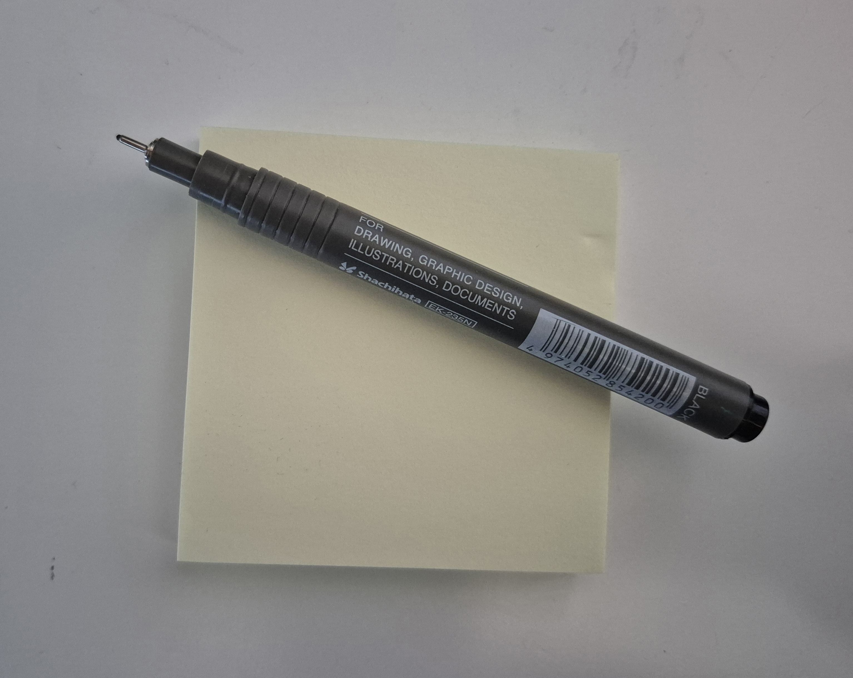
Group Activity
Have you come across anyone with any of these or other arthritic conditions? How important is exercise in the management of arthritis?
Work in pairs, put ideas on a post-it or interactive board and then share with the group.

Slide 7
Rheumatoid Arthritis (RA)
Chronic Systemic Inflammatory disease
Synovitis (Inflammation of the synovial membranes)
Symmetrical involvement of peripheral joints especially hands and feet. All joints can be affected eg cervical spine
Symptoms include joint pain/ heat/ swelling. Prolonged stiffness, generalised fatigue with exacerbations and remissions, rheumatoid nodules.
Changes in body composition. Reduced muscle mass and increased fat mass.
Notes:
When you have RA, your immune system attacks the lining of your joints (the synovial lining) hence the term Auto-immune disease.
RA is a systemic disease, meaning that it doesn’t just affect joints. RA can affect a person’s whole system, including organs such as the lungs, heart and eyes.
It tends to affect the small joints of the hands and feet first – often the knuckle joints in the fingers. It is described as a polyarthritis, meaning that many joints can be inflamed
As the disease progresses can lead to joint deformity/ affect organs can be very very debilitating.
Arthritis Research UK. Possible leaflets, Useful for your patients.
Royal National Mineral Hospital website: Useful

Slide 8
RA
History often gives clues. Early Morning Stiffness/ fatigue/ Lack of Mechanism of Injury/ Synovitis/ extra articular manifestations (Skin rashes, nail abnormalities, bowel disturbances, iritis)
Diagnosis can be difficult, prolonged and expensive
DAS 28: (RA Calculator, Count Swollen/Tender Joints)Disease Activity Score
SF36: (Short Form Health Survey )Generic outcome measure
RAQoL: Measures pain and fatigue along with disease specific aspects.
Notes:
An important feature of rheumatoid arthritis, is synovitis: pain, swelling and possibly redness around your joints. Hands and feet are often affected first, though RA can start in any joint. stiffness in your joints when you get up in the morning or after sitting for a while, which lasts for more than 30 minutes and has no other obvious cause fatigue that’s more than just normal tiredness
DAS: An assessment looking at the number of tender and swollen joints (out of the 28), the erythrocyte sedimentation rate (ESR) or C reactive protein (CRP) both of which measure the degree of inflammation in the blood, and the patient’s ‘global assessment of health' (indicated by marking a 10 cm line between very good and very bad). These results are then fed into a formula to produce the overall disease activity score. A DAS28 of greater than 5.1 implies active disease, less than 3.2 well controlled disease, and less than 2.6 remission.
In the foot for example, can lead to changes in the shape of the foot and most important of which are dorsal subluxation of the toes and toes deformity. Plantar prominence of the metatarsal heads and anterior displacement of the plantar fat pad which leaves the metatarsals head without cushioning. This is just in the feet.

Slide 9
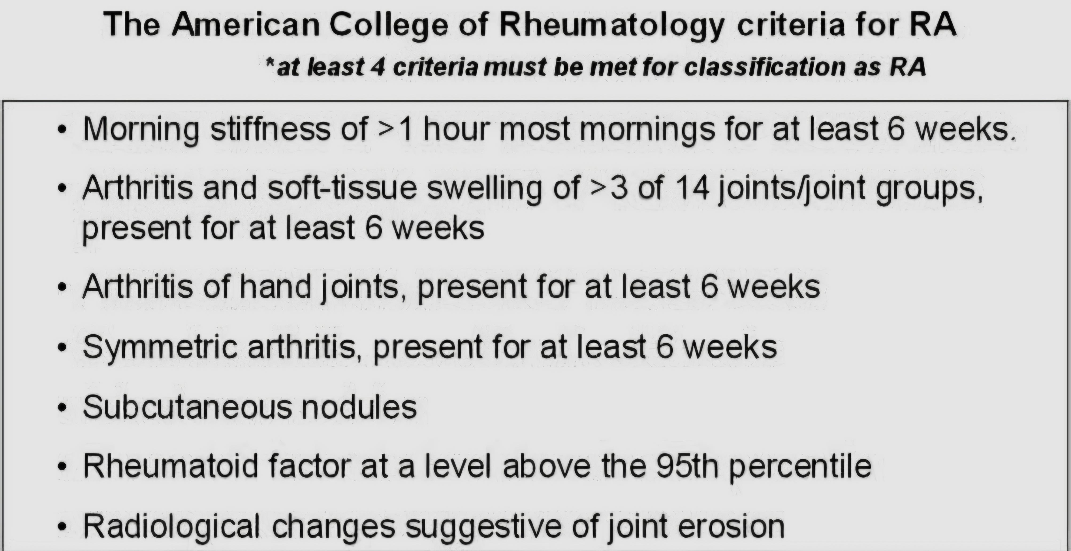

Slide 10
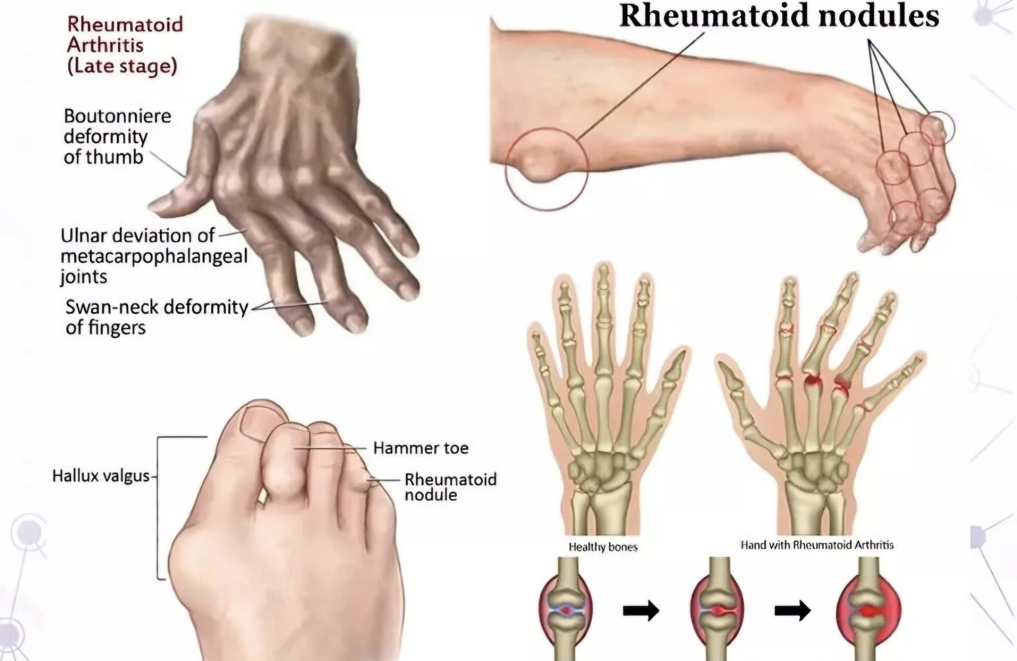
Rheumatoid Arthritis

Slide 11
Some management strategies to consider
MDT approach. Specific to the individual
Education. Examples: Joint protection principals, Sleep Hygiene, Active Rest/ Pacing
Exercise prescription/programme.
Remember this is Life Long Management.
Notes:
MDT: treatment in general is to help remission – a state - no or minimal inflammation in the joints and the body. There are a lot of different treatment options for people with rheumatoid arthritis
Usually, the first treatment will be a traditional medicine called a conventional synthetic disease-modifying antirheumatic drug (shortened to DMARD’s). This group includes methotrexate. Monitored regularly

Slide 12
What is Osteoarthritis
Active disease process affecting the whole joint unit
MSK disorder accompanied by inflammation represented by the elevated production of pro-inflammatory cytokines
Wear - Flare - Repair
Notes:
Complex multifactorial disease. Affecting both weight-bearing and non-weight bearing joints.
Affects the Articular cartilage but also the subchondral bone of a synovial joint.
What it is not: ‘Wear and Tear’ Predominantly involving the protective layer on the ends of bones — wore down after years of use. Just not the case

Slide 13
Wear – Flare – Repair
Wear = Biomechanical factors
Flare = Inflammatory mediators + mechanical irritation
Repair = Body’s natural ‘healing’ response

Slide 14
Wear – Flare – Repair
Wear = Biomechanical factors
Flare = Inflammatory mediators + mechanical irritation
Repair = Body’s natural ‘healing’ response

Slide 15
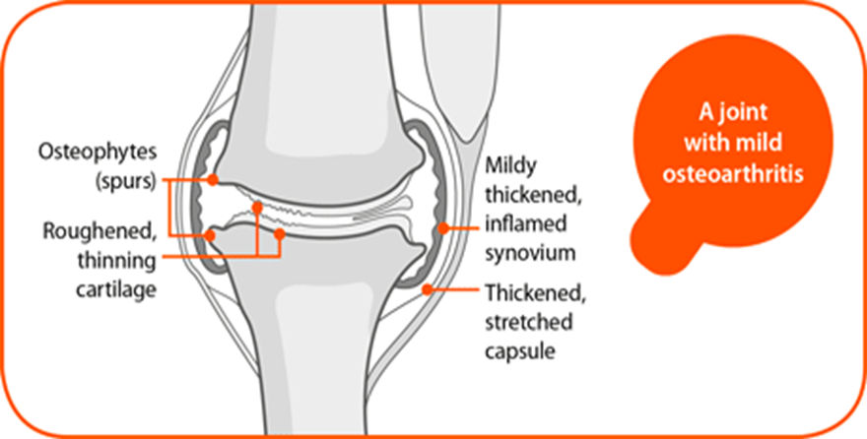
Pathological Changes – Early
Notes:
Common sites where you might see these changes include: Knee/Hip
Then Hand and wrist then Foot and ankle Nb Not just the WB joints.

Slide 16
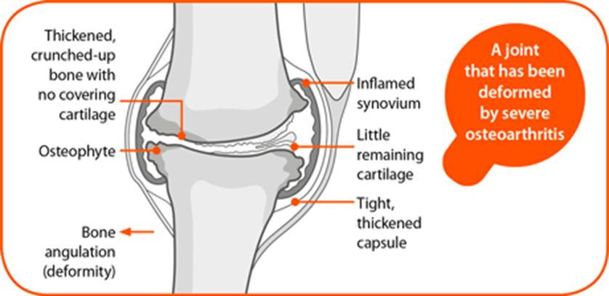
Pathological Changes – Progressive

Slide 17
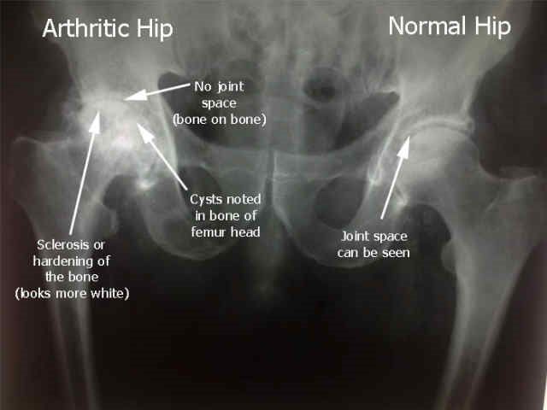
Radiographic Changes
Notes:
Example Hip Joint: Note that it Links well with ortho powerpoint.

Slide 18
Aetiology
Risk factor | Considerations
Age | Late 40s and older sees a greater prevalence of symptomatic OA; and continues to increase with age.
Trauma | A major injury or operation to joint structures or the articulating surface of the joint.
Occupation | If your job involves heavy physical work. Dockers, plumbers and farmers found to have OA.
Exercise | High impact sports present an increased risk of developing OA, irrespective of injury.
Gender | Men <50 have a higher prevalence and incidence; women >50 have a higher prevalence and incidence. More common and severe in women
Ethnicity | A notable higher prevalence in Europeans and African populations than Asians
Genetics | There is genetic susceptibility to the disease. Children of parents with early onset OA are at a personal higher risk of developing the disease.
Obesity | Strongest modifiable risk factor. Being overweight in late-30s is a risk factor for developing knee OA
Notes:
Age: Maybe due to loss of Muscle bulk/ decrease activity/ Weight gain
Trauma: Fractures through the articulating surfaces increases risk of OA surfaces / ruptured ACL another example.
Gender: Females: After the menopause: Could also be linked with higher levels of adipose tissue in females BMI
Weight unclear: mechanical overloading and the systemic metabolic alterations with chronic low grade inflammation that is characterised with Obesity.

Slide 19
Diagnostic Criteria
Aged 45 or older
Joint pain that gets worse on activity
Joint stiffness not there in the mornings, or lasts less than 30 minutes
Notes:
As mentioned x-rays might not be that useful. Could be used to rule other aspects out?

Slide 20
Clinical Presentation
Sign/Symptom | Presentation
Pain | Associated with movement; often at the end of the day or associated with long bouts of activity
Stiffness | After long period of rest or first thing in morning; eases relatively quickly with gentle movement
Crepitus | Creaking or grinding on movement; palpable and often associated with pain
Swelling | Palpable generalised soft joint swelling; may also present as specific swelling, typically at the back of the knee
Osteophytes | Boney swellings at margins of joint. Particularly noticeable in distal finger joints associated with hand OA
Giving way | Associated with muscle weakness or ligamentous laxity; reduced proprioception; particularly affects the knee joints
Reduced ROM | Joints with large range of movement generally affected e.g. hip, knee and shoulder; adaptive shortening of associated muscle groups
Muscle wasting | Most noticeable in the large anti-gravity muscles of the lower limb e.g. quadriceps and gluteal muscles; reduced strength and endurance

Slide 21
Relationship of symptoms and signs in OA
Inflammation
Joint effusion
Pain
Instability
Muscle Inhibition
Loss of Range of movement
Muscle Atrophy
Reduced Function

Slide 22

Possible yellow flags to consider
Anxiety
Depression
Fear avoidance
Catastrophising
TASK: What do you understand by these yellow flags?
Notes:
Barriers to rehab.

Slide 23
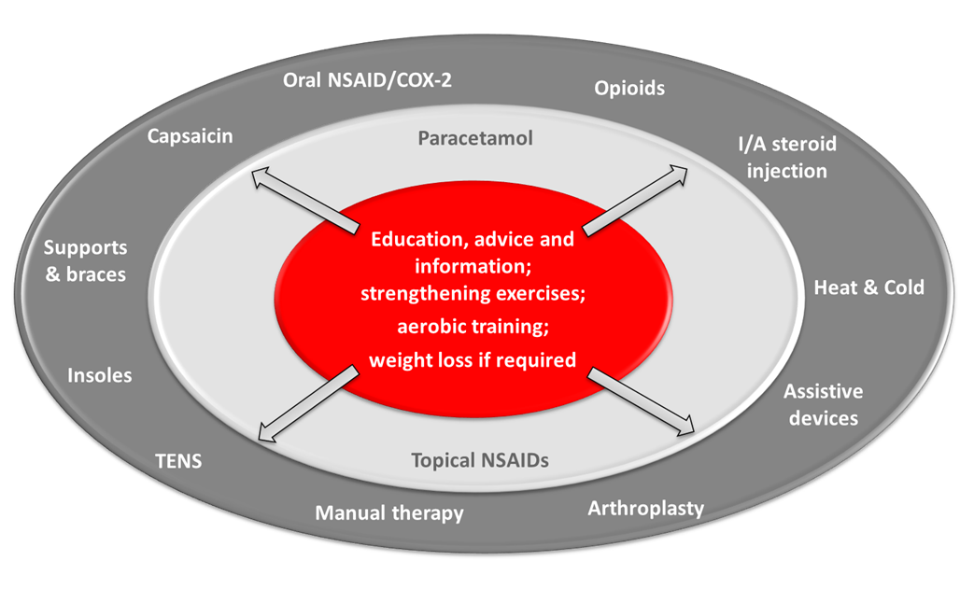
NICE Management Guidelines
Note –
Exercise prescription is at the core/focus of treatment/management of OA.
Notes:
The core is what we will be doing. What we do.

Slide 24
Exercise Benefits for OA
EXERCISE
Reduce pain
Improve physical function
Improve social function
Re-enable
Increase muscle strength
Increase joint range
Improve joint position sense
Increase general fitness
Improve mood and well-being
Notes:
really does link back to the Introduction to THERAPEUTIC EXRECISE powerpoint.
We can see here that there are so many things which Exercise can be of benefit for. Physiological Affects and Psychosocial Affects​
Recent Conference I went to at the Etihad: Speaker Professor Karim Khan: Labelled a new term “Smokerdiabesity” (this was said with tongue and cheek). Highlighting that if you are in the lower 25% percentile of exercise then you are at a greater risk of dying than someone would had all three of the risk factors above. IE exercise is so important.

Slide 25
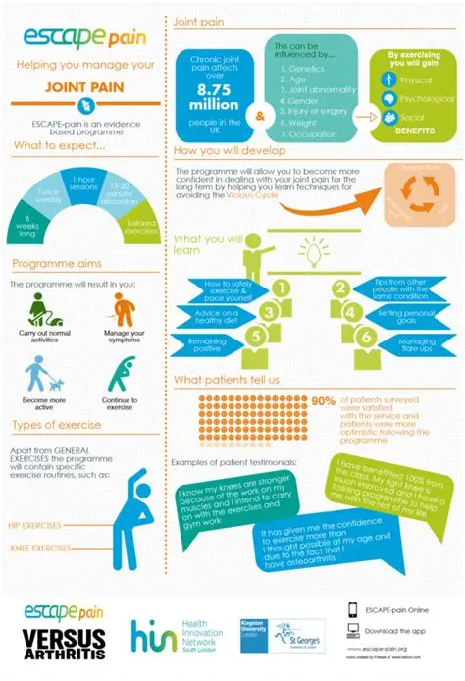
As previously mentioned, exercise programmes are varied(NOT just traditional PARS/ERS).
ESCAPE pain is an evidenced based exercise programme.
We will discuss ESCAPE pain further in the planning of exercise programmes sessions for special populations.

Slide 26
Not just exercise...... Self-management education
Realistic goal setting
Benefits of exercise
Managing flare ups
Pacing activities
Ice and heat at home
Exercise in the long term
Healthy diet

Slide 27
Summary
Osteoarthritis is an active clinical syndrome of the joint unit
Biomedical and psychosocial presentation
Exercise and self-management education are core management strategies

Slide 28
Useful Resources
https://bnssg.sdmcharts.co.uk/conditions/hip-osteoarthritis
https://www.nhs.uk/conditions/arthritis/
https://www.versusarthritis.org/about-arthritis/
National Institute of Health and Clinical Effectiveness. Osteoarthritis: Care and Management in Adults. NICE February 2022
Fransen M, McConnell S, Harmer AR, Van der Esch M, Simic M, Bennell KL. Exercise for osteoarthritis of the knee. Cochrane Database of Systematic Reviews 2015, Issue 1.
Notes:
https://bnssg.sdmcharts.co.uk/

Slide 29
Group Activity
Any takeaways from this session?
Has it helped you in your understanding of OA/RA?
Work in pairs, put ideas on a post-it or interactive board and then share with the group.

Slide 30

ANY QUESTIONS

Slide 31
NEXT-PART TWO (Course 2)
AIM:
To apply the principles of planning and designing an exercise progamme for special populations.

